Slide 1
Leeds Beckett University
Cloud Computing Development
Dr Anatoliy Gorbenko
E-mail: A.Gorbenko@leedsbeckett.ac.uk Office: CAE118
Kiran Voderhobli
E-mail: k.voderhobli@leedsbeckett.ac.uk Office: CAE228

Slide 2
Cloud Computing Development
Lecture: Cloud Computing Models: IaaS, PaaS, SaaS
Anatoliy Gorbenko
Kiran Voderhobli

Slide 3
Lecture Agenda
Service models
Deployment models
Cloud economics
Cloud Computing Models

Slide 4
Cloud Computing
IaaS (Infrastructure-as-a-Service)
PaaS (Platform-as-a-Service)
SaaS (Software-as-a-Service)
Service Models

Slide 5

Cloud Computing Analogy
Imagine, you just moved to a city and you are looking for a place to live:
Build a new house ?
Buy an empty house ?
Live in a hotel ?

Slide 6

Cloud Computing Analogy
Building a new house
You can fully control everything
Your build exactly you want
But that is a hard work …

Slide 7

Cloud Computing Analogy
Buying an empty house
You can customize some part of your house and bring your own furniture.
You never can change the original architecture.

Slide 8


Cloud Computing Analogy
Living in a hotel/ apartments
Just is enjoy your life!
There is nothing you can do with the house except living in it.

Slide 9
Cloud Computing Analogy
IaaS
Similar to build a new house
You can rent some virtualized infrastructure and build up your own IT system among those resources, which may be fully controlled.
PaaS
Similar to buy an empty house
You can directly develop your IT system through one cloud platform, and do not care about any lower level resource management.
SaaS
Similar to live in a hotel
You can directly use some existed IT system solutions, which were provided by some cloud application service provider, without knowing any detail technique about how these service was achieved

Slide 10
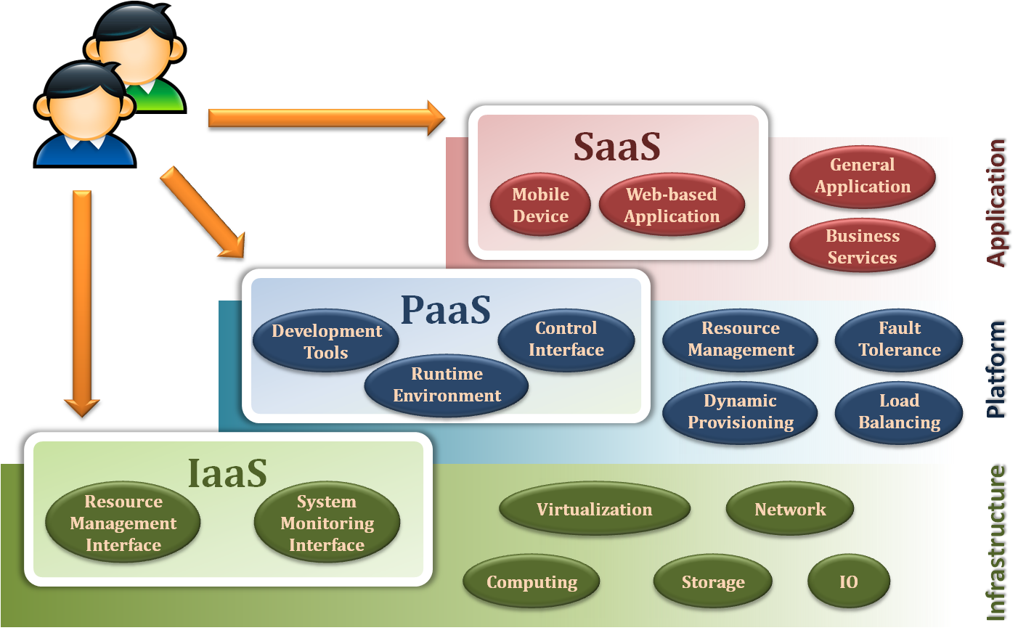
Service Models Overview

Slide 11
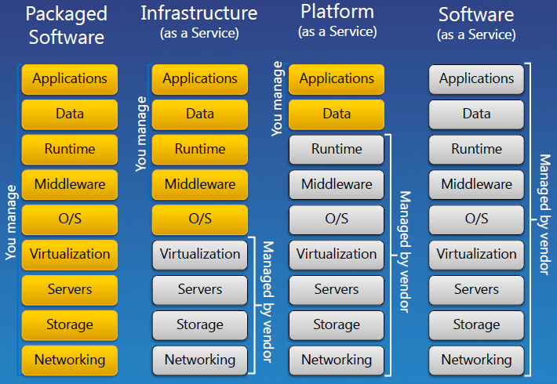
Basic Service Models Stack
IaaS is a form of cloud computing that provides virtualized computing resources (virtual instances) over the internet.
PaaS provides a platform allowing customers to develop, run, and manage applications without the complexity of building and maintaining the infrastructure.
SaaS is a software licensing and delivery model in which software is licensed on a subscription basis and is centrally hosted; it is sometimes referred to as "on-demand software".

Slide 12


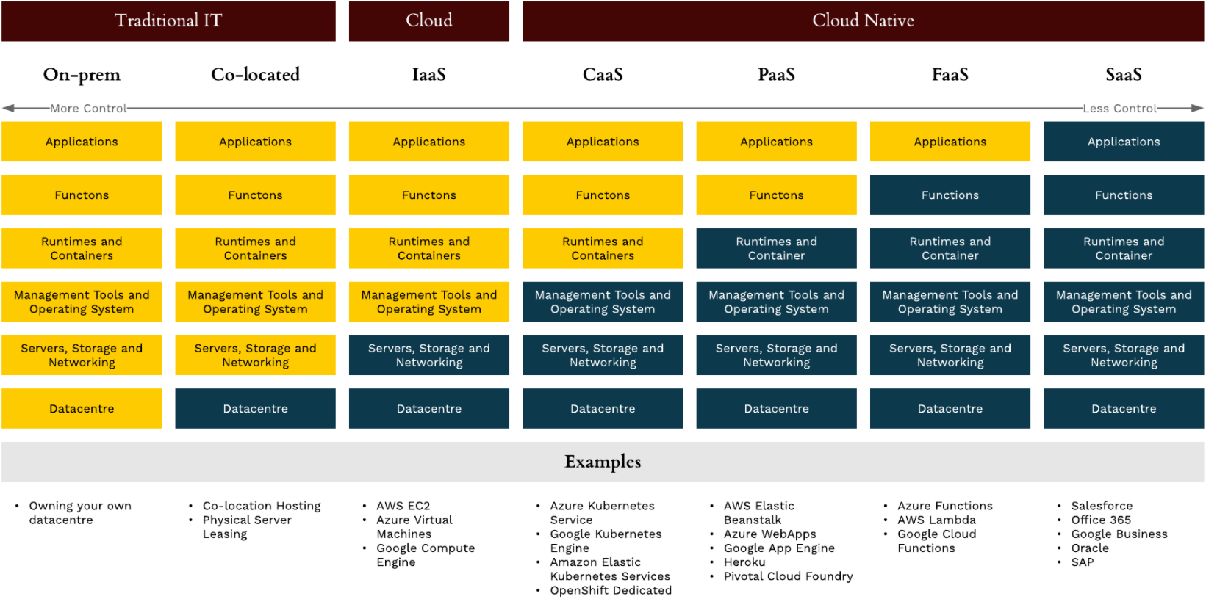
More Models
Containers as a service (CaaS) is a special sub-type of the IaaS that allows software developers to manage containers by using container-based virtualization. Containers are a form of “lightweight” virtualization at the operating-system level. Containers are fully packaged and portable computing environments sharing the machine’s operating system kernel which considerably reduce software overheads.
Function as a Service (FaaS) provides the ability to deploy what is essentially a single function, or part of an application. FaaS is designed to potentially be a serverless architecture. Serverless computing is a cloud computing execution model in which the cloud provider dynamically manages the allocation of machine resources for client’s function. Pricing is based on the actual amount of resources consumed by an application, rather than on pre-purchased units of capacity.

Slide 13
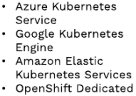
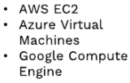
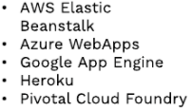


Cloud Computing Model Examples
IaaS
CaaS
PaaS
FaaS
SaaS

Slide 14
Public Cloud
Amazon,
MS Azure,
GoGrid, etc.
Private Cloud
E.g. LBU oVirt
Community Cloud
Similar to Grid Computing and VO
Hybrid Cloud
Private + Public
Sensitive data are stored in Private Cloud
Private Cloud used on high demands
Cloud Computing
Deployment models

Slide 15
Cloud Computing
For the market and enterprises
Reduce initial investment and time
Reduce capital expenditure
Reduce maintenance cost
Improve resource utilization
For the end user and individuals
Reduce local computing power
Reduce local storage power
Variety of thin client devices
Cloud Economics

Slide 16
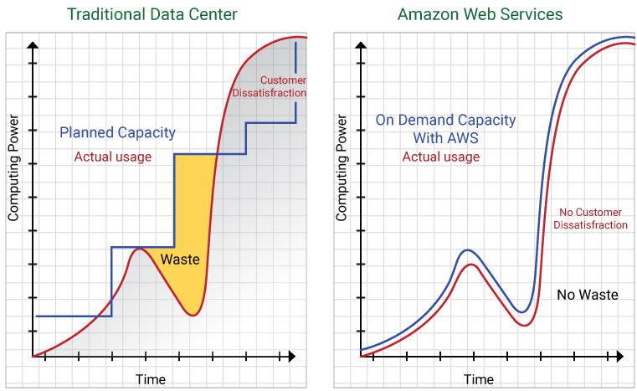
Cloud Computing Economics
/ Cost
/ Cost
Capital expenditure

Slide 17
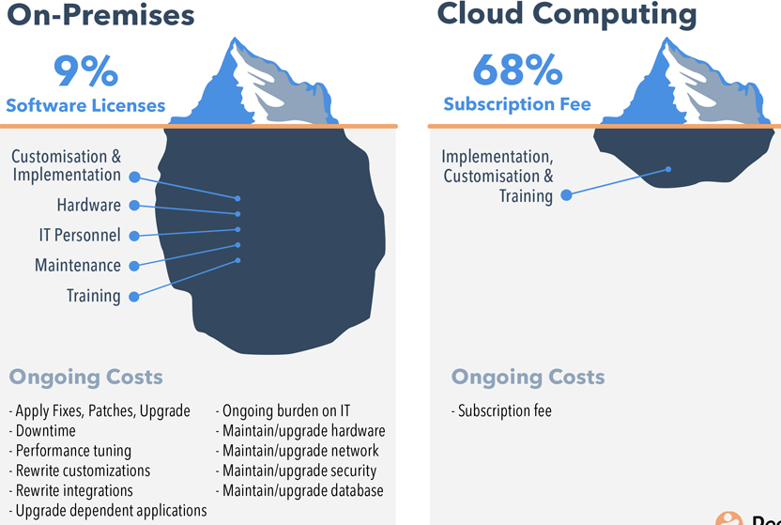
Cloud Computing Benefits
Pros:
Complete physical access
Clear ownership
Cons:
Significant capital expenditure
Expensive to maintain
Limited performance
Pros:
Scalable and reliable performance
Known and predictable costs
Professional infrastructure
Cons:
Lack of physical access
Relies on third-party
Security fear

Slide 18
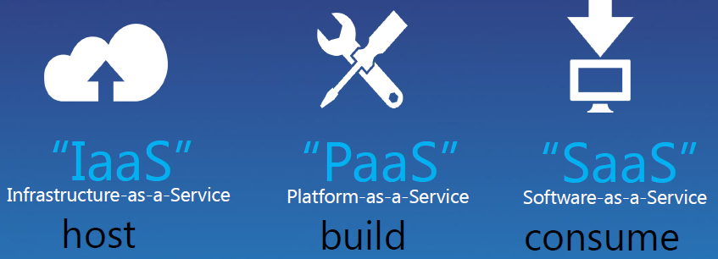
Cloud Computing

Slide 19
Cloud Computing
G Suite / Google Apps (Gmail, Hangouts, Calendar, Google+; Drive; Docs, Sheets, Slides, Forms; Sites)
Microsoft Online Services / Office 365 (Exchange, Skype for Business, SharePoint, Office Online (Word, Excel, PowerPoint, OneNote; Outlook.com, People, Calendar, OneDrive))
salesforce.com
Box
Google Compute Engine
Amazon AWS (EC2)
Microsoft Azure
GoGrid
Rackspace Cloud
IBM cloud computing
FUJITSU Cloud IaaS TPS5
...
Microsoft Azure
Google App Engine
Amazon AWS (Simple Storage Service (S3), Amazon Relational Database Service (RDS), etc.)
Force.com
SAP Cloud Platform
VMware vCloud Air
Heroku
Red Hat OpenShift Online

